Slide 1

Tweets and blogs
& why you should care….

Slide 2
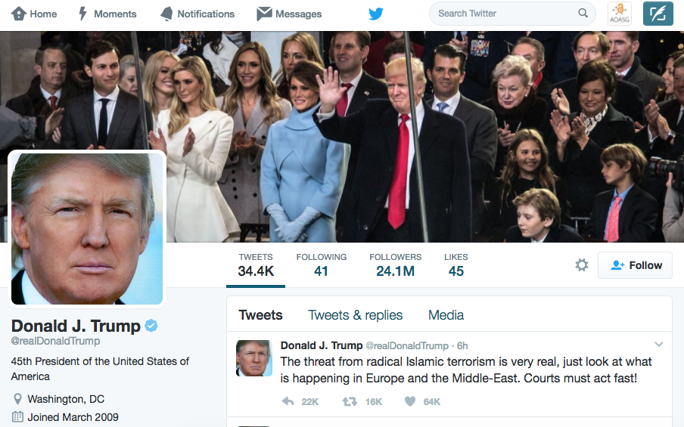
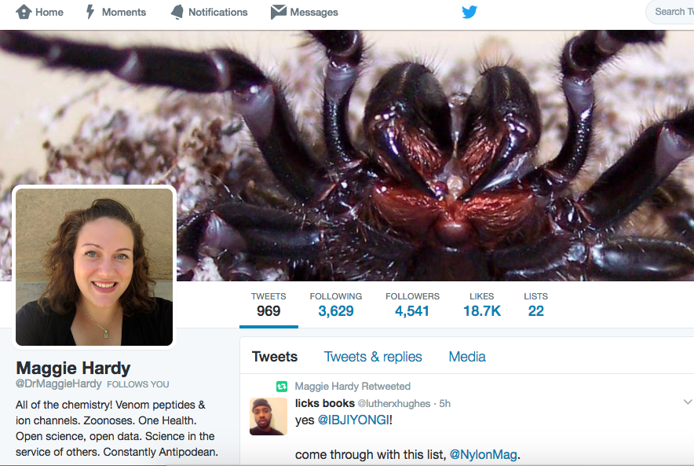
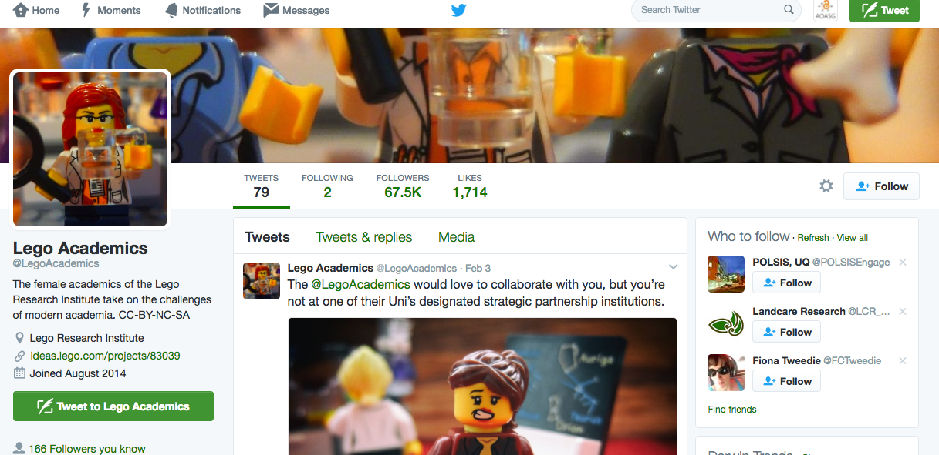
What makes a great tweeter?

Slide 3
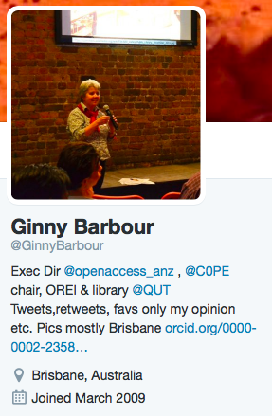
My rules of tweeting
Be yourself – once you’ve decide who you are
Stick to what you know (ish)
A tweet is forever

Slide 4
What makes a great tweet?
Timely
On topic
….and the right length!

Slide 5

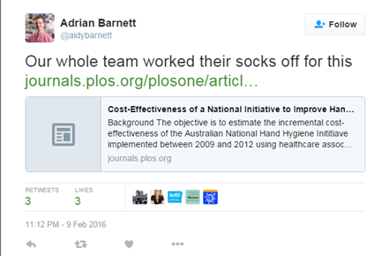
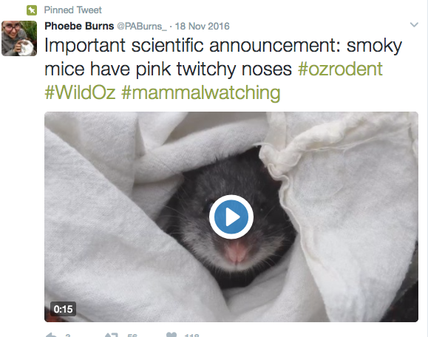

Slide 6
So, let’s write some tweets!
……………………………………………………………………………………………………………………………………………………………………………………………..…………………………………………………………………………………………………………………………………………………………………………………
……………………………………………………………………………………………………………………………………………………………………………………………..…………………………………………………………………………………………………………………………………………………………………………………
……………………………………………………………………………………………………………………………………………………………………………………………..…………………………………………………………………………………………………………………………………………………………………………………
……………………………………………………………………………………………………………………………………………………………………………………………..…………………………………………………………………………………………………………………………………………………………………………………

Slide 7
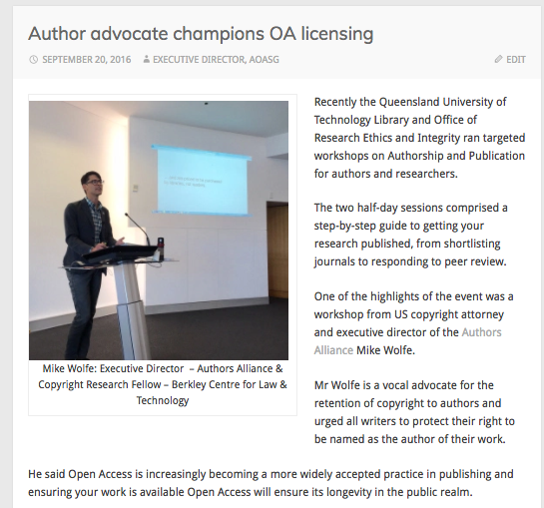



But sometimes a tweet isn’t enough
If you want to blog, you can build your own based on…
Wordpress
Ghost
Jekyll
Medium
Or many others

Slide 8
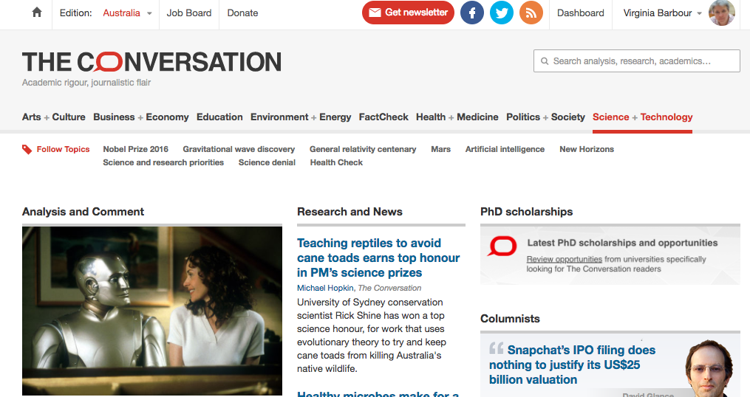
or someone else’s blog

Slide 9
What makes a great tweet? blog
Timely
On topic
….and the right length!

Slide 10
My rules of tweeting blogging
Be yourself – once you’ve decide who you are
Stick to what you know (ish)
A blog is forever
write for the 14 year old in your life!
and….

Slide 11
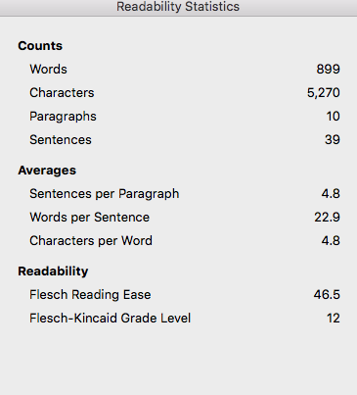
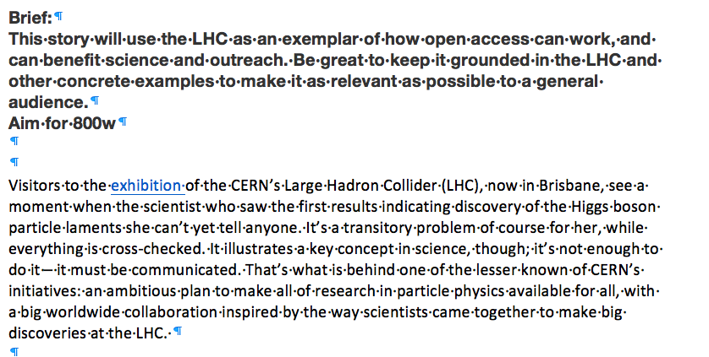
Stick to the brief!

Slide 12
So, let’s write a blog intro….
30 words on your work, or something else you care about

